Slide 1

CS-Cyber Security
Week-2 Lecture-2
Semester- Spring 2026

Slide 2
Instructor Contact Details
Name: Mahek Kausar
Course Instructor: Cyber Security
Credit Hours: 3
Designation : Lecturer
Office Location: 2st Floor D-Building
Email: mahek.kausar@ucp.edu.pk
Visiting Hours: Thursday-Friday (10:30-12:30)

Slide 3

Introduction to Computer System Threats
A computer system threat is any potential danger that can exploit vulnerabilities in a system and compromise its confidentiality, integrity, or availability (CIA triad).
  Computer threats target:
  Hardware
  Software
  Networks
  Data
  Users

Slide 4
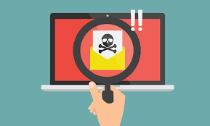
What is a Threat
A threat is a possible event that can cause harm to a computer system or organization.
Example:
A hacker attempting to steal passwords
A virus corrupting files
A power failure damaging hardware

Slide 5
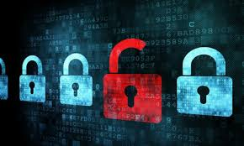
Relationship Between Threat, Vulnerability, and Attack
Vulnerability → Weakness in a system
Threat → Potential danger
Attack → Actual exploitation of vulnerability
Example:
If a system has weak passwords (vulnerability), a hacker (threat) may perform brute-force login attempts (attack).

Slide 6
Types of Computer System Threats
Internal Threats (Insider Threats)
  These originate from within the organization.
Sources:
  Employees
  Administrators
  Contractors
  Business partners

Slide 7
Types of Computer System Threats
Types:
  Malicious Insider – Intentionally steals or damages data.
  Negligent Insider – Accidentally exposes information.
  Compromised Insider – Account taken over by attacker.
Example:
  An employee copying confidential data to a USB drive.

Slide 8
Case Study
At 9:15 AM, the university's finance department discovers that several student fee records have been modified.
At the same time:
  An employee's account was used at 2:00 AM.
  The login originated from an unusual IP address.
  A USB device was connected to the employee's computer yesterday.
  A former employee's account is still active.
  The firewall detected multiple failed login attempts from another country.
  Someone sent a phishing email to three finance employees.
  The database administrator says they did not modify anything.
Who is the most likely attacker?

Slide 9
Case Study
ABC University has a centralized server that stores:
  Student records
  Exam results
  Payroll data
  Research documents
Mr. Ali is a senior system administrator who has full access to the database. Recently, the university management announced budget cuts, and Mr. Ali feels unfairly treated after being denied a promotion.
Two weeks later:
  Some student grades are mysteriously modified.
  Payroll data is leaked online.
  Logs show access from Mr. Ali’s admin account at unusual hours.

Slide 10
Case Study
Identify the Threat
  What type of threat is this?
  Is this malicious, negligent, or compromised insider?
  What vulnerabilities might have enabled this?
Identify:
  Asset → What is being protected?
  Threat Actor → Who caused the incident?
  Impact → Academic, financial, reputational damage?
  Likelihood → High / Medium / Low?

Slide 11
Case Study
Students must propose controls such as:
  Role-Based Access Control (RBAC)
  Least Privilege Principle
  Multi-Factor Authentication (MFA)
  Log monitoring and SIEM systems
  Separation of duties
  Regular audits

Slide 12
Case Study
How could this incident be detected earlier?
Should administrators have unlimited access?
How does insider threat differ from external hacking?

Slide 13
Types of Computer System Threats
External Threats
  These originate outside the organization.
Sources:
  Hackers
  Cybercriminal groups
  Hacktivists
  Nation-state actors
Example:
  The WannaCry attack spread globally and encrypted hospital and corporate systems.

Slide 14
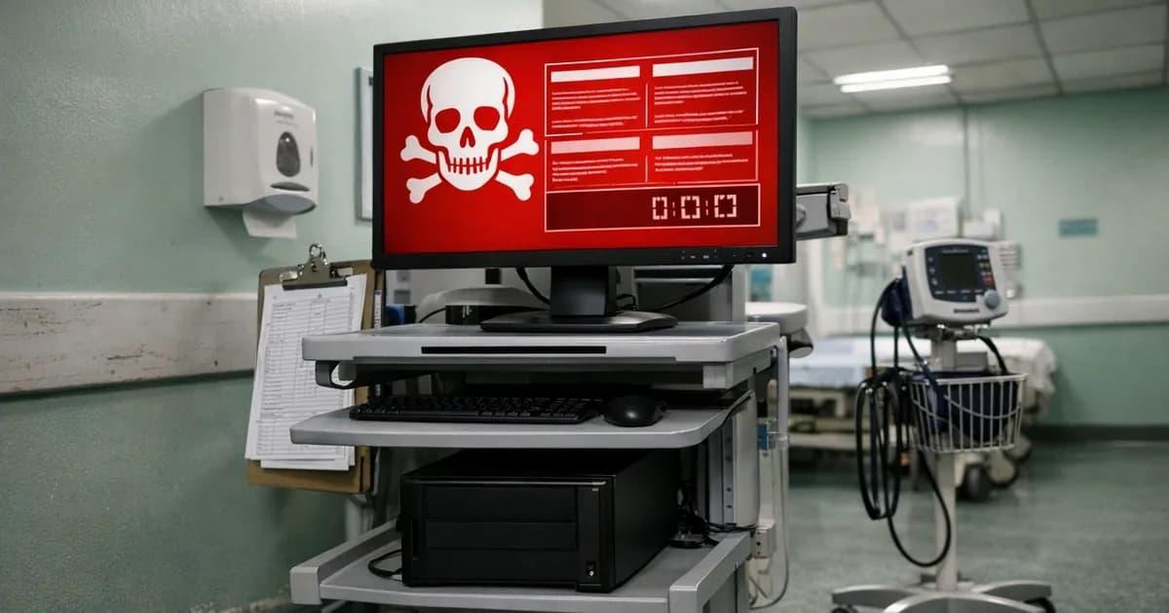
Wannacry

Slide 15
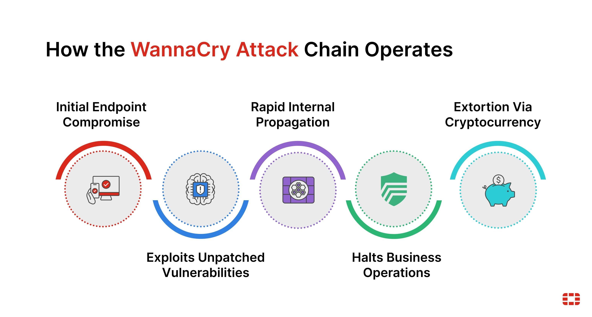
Wannacry

Slide 16
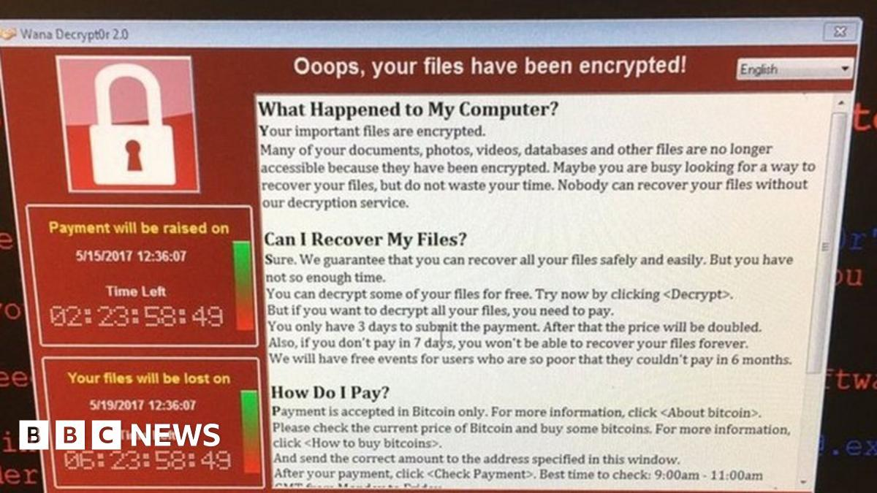
Wannacry

Slide 17
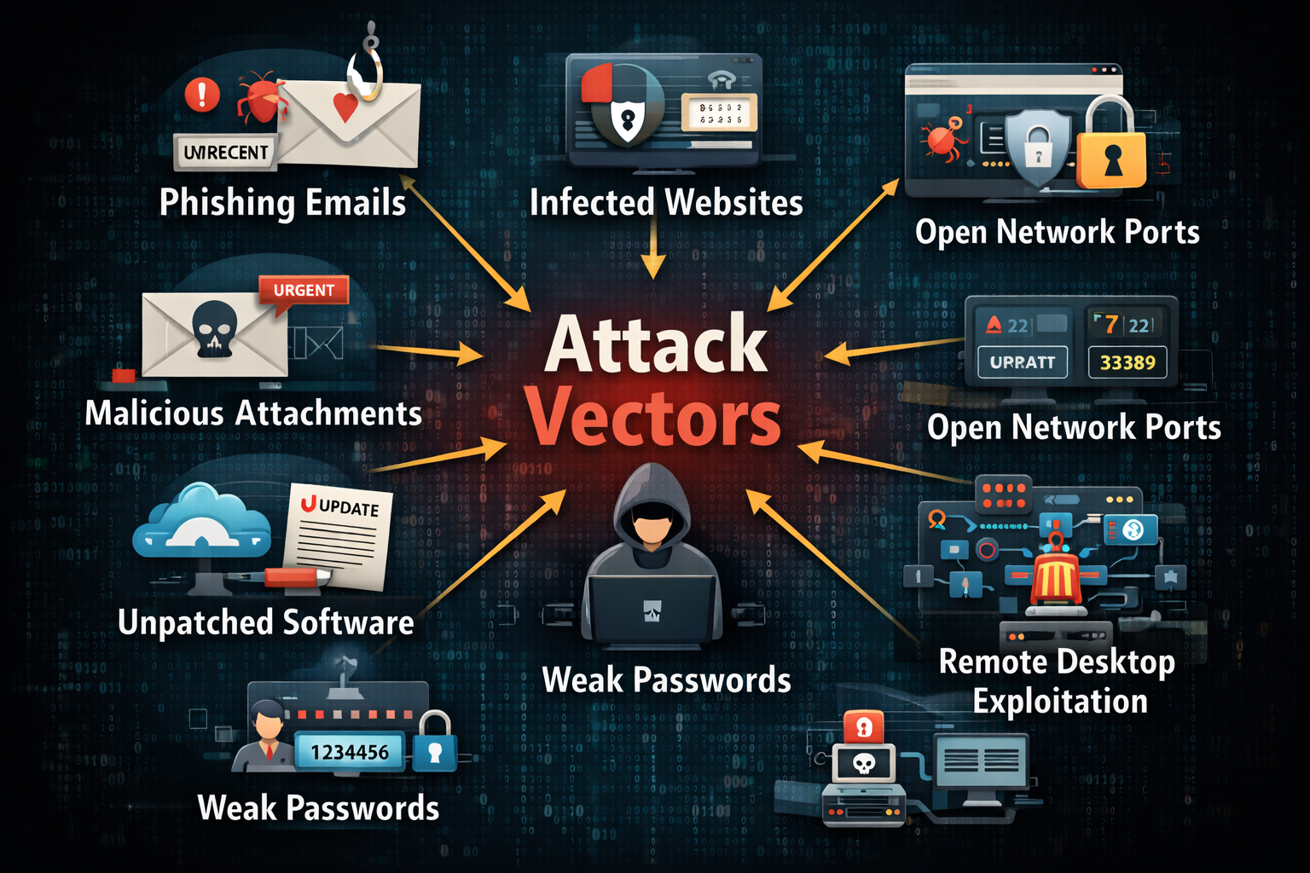

Slide 18
Attack Vectors
An attack vector is the path or method used by an attacker to gain unauthorized access.
  Common Attack Vectors:
  Phishing Emails
  Malicious Attachments
  Infected Websites
  Weak Passwords

Slide 19
Attack Vectors
Common Attack Vectors
  Unpatched Software
  Open Network Ports
  USB Devices
  Remote Desktop Exploitation
Example:
The SolarWinds supply chain attack used a software update as an attack vector to compromise organizations.

Slide 20
Common Cyber Threats
1. Malware
  Virus
  Worm
  Trojan
  Spyware
  Ransomware
2. Phishing
  Fraudulent communication pretending to be legitimate.

Slide 21
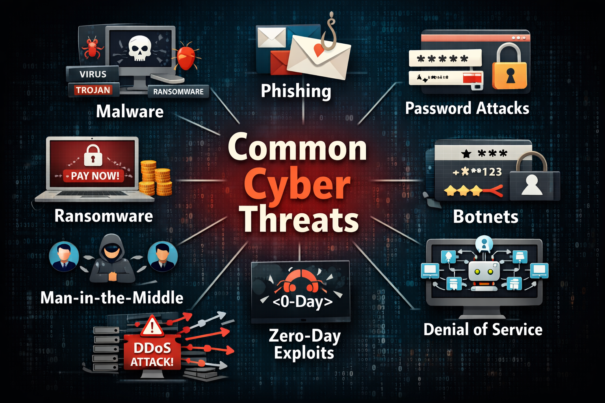
Common Cyber Threats

Slide 22
Common Cyber Threats
3. Ransomware
  Encrypts files and demands payment.
4. Password Attacks
  Brute force
  Dictionary attacks
  Credential stuffing
5. Man-in-the-Middle (MITM)
  Intercepting communication between two parties.

Slide 23
Common Cyber Threats
6. Zero-Day Exploits
  Attacks exploiting unknown vulnerabilities.
7. Botnets
  Compromised devices controlled remotely.
  Example:
  The Mirai botnet attack used IoT devices to launch large-scale DDoS attacks.

Slide 24
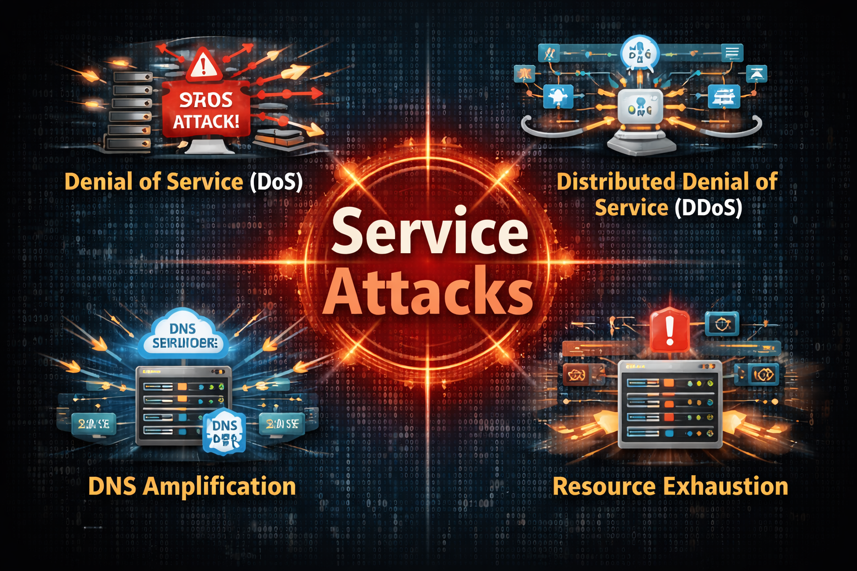

Slide 25
Service Attacks
Service attacks target system availability and performance.
A. Denial-of-Service (DoS)
  Overwhelms a system with traffic to make it unavailable.
B. Distributed Denial-of-Service (DDoS)
  Multiple compromised systems attack a single target.
C. Resource Exhaustion
  Consumes CPU, memory, or bandwidth.

Slide 26
Service Attacks
D. DNS Amplification Attacks
  Abuses DNS servers to flood victims with traffic.
Impact of Service Attacks:
  Website downtime
  Financial loss
  Customer dissatisfaction
  Business interruption

Slide 27
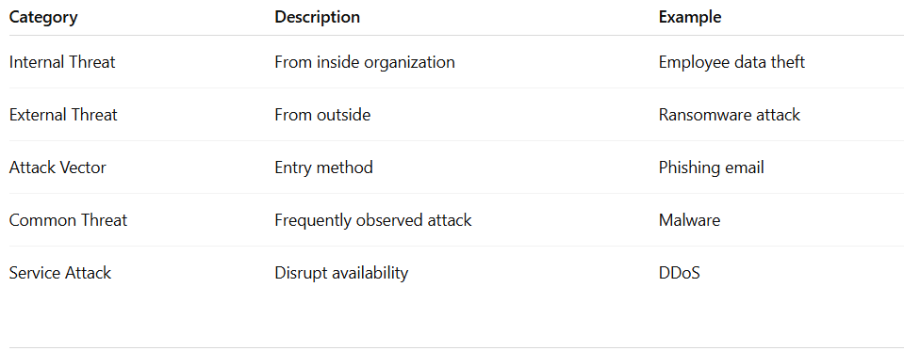
Summary

Slide 28
Thank You
Questions?

